Slide 1
BFCM
2023 Trends, Prediction and Tactics

Slide 2
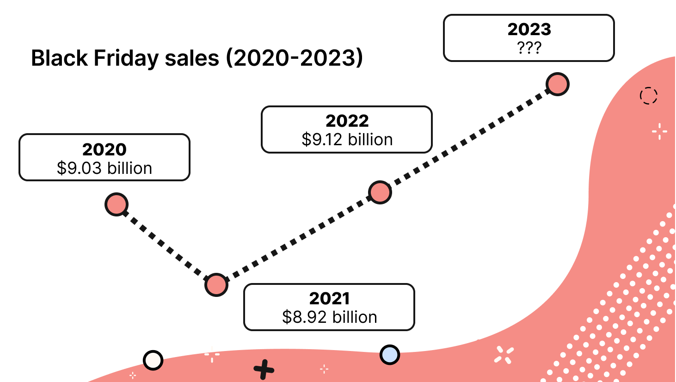
2019
2020
2021
2022
2023

Slide 3
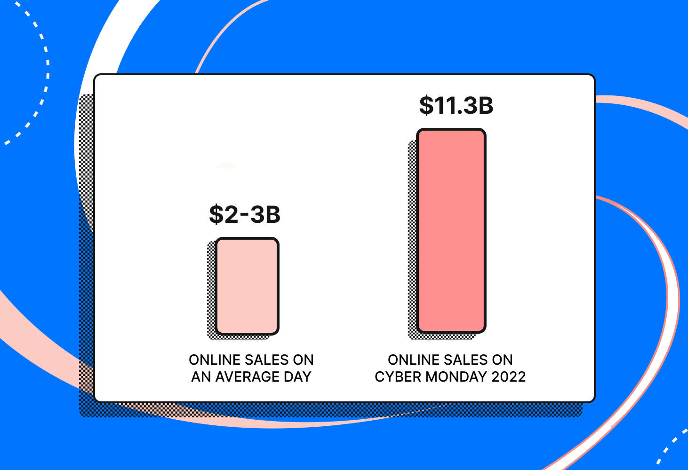
CM vs BF
Online Sales are 5% higher on CM vs BF
On Average online sales are 5x higher on CM
Plan for your bigger promotions on CM when consumers are more prepared to buy online

Slide 4
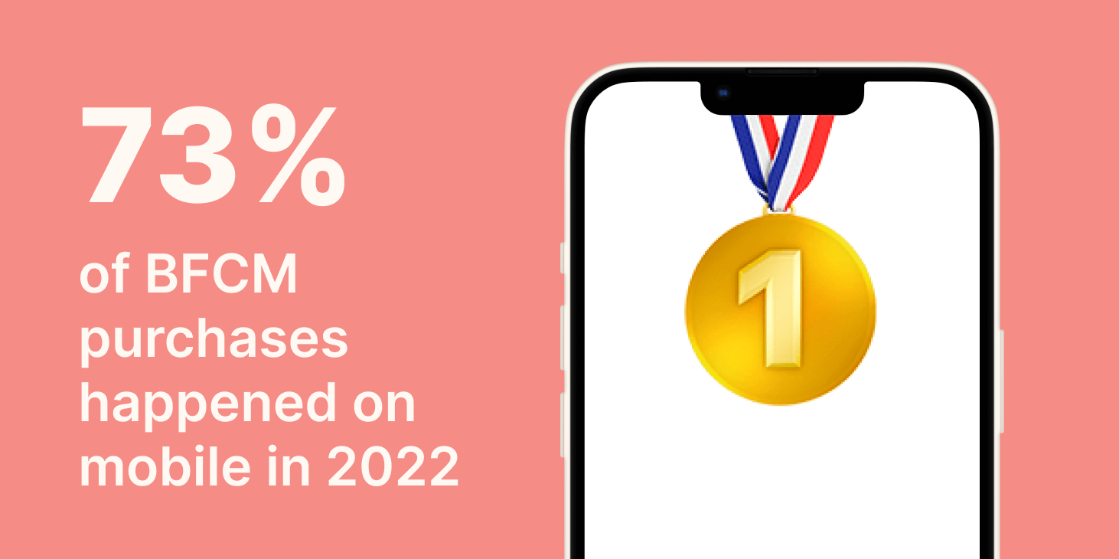
Mobile is key
More purchases are made on mobile
More BFCM purchases happen on a mobile device than ever before. According to Shopify, 73% of sales for merchants on the platform during BFCM were made by mobile in 2022, compared to 71% in 2021.
Optimize mobile, make sure UI/UX on mobile is optimized.

Slide 5
Buy now Pay Later
There are now several Buy Now Pay Later (BNPL) service providers available, and consumers are happy to take advantage of them. According to Adobe, BNPL use rose 85% during BFCM compared to the week before in 2022. As well, BNPL revenue rose 88%.
It’s worth noting that BNPL is a proven conversion tool — according to RBC Capital Markets, BNPL can increase conversions by 20% to 30%.
Find a BNPL provider that works for you.
-Klarna
-Affirm
-Afterpay
-Shopify

Slide 6
Discounts are at Record Highs
Adobe reported that discounts hit record highs in 2022, peaking at an average of 25% off the listed price on Cyber Monday. Some categories saw deeper discounts than others, such as 34% off toys, 20% off computers, and 18% off apparel.
Be prepared to compete with discounts if you want high volume sales.

Slide 7
US Chamber of Commerce – Trend highlights
2/3 (63%) consumers will shop in store for BFCM. This is up from 53% from last year.
Live Stream shopping is expected to take off
Channelize.io
TikTok is becoming a major driver in the retail space. They now offer $100 free marketing credit to new advertisers

Slide 8
Predictions
Customers will expect discounts
Marketing will start earlier – many brands will launch promotions mid November
Large brands are still over-inventoried and will market earliy and often and will drive prices down for core products
Overall spending will be largest ever at $21.36B for BFCM, up from $20.42B in 2022 (about 5% increase)

Slide 9
Tactics
Start promoting your sale early. Use blogs, influencers, email and text to get consumers aware of what you’re doing early in November.
Optimize your mobile experience
Make sure your chat widgets, pop-ups, etc. don’t get in the way of your mobile experience
Have a buy now pay later option
Prepare a discount strategy that keeps your margin in-tact but competes.
I highly recommend gift cards – high perceived value low margin impact

