Slide 1
Financing your business

Slide 2
Issue….
There are really only three ways to finance your business.
Equity
  Diminishes founder’s upside
  Often hard to find interest unless you give up control
  It is the most expensive option (if you are successful)
Debt
  Traditional Banks
    Requires collateral and PG
  Other
Profits
  You can’t even get here unless you figure out the first two options

Slide 3
 | What is it | Terms | How I use it | Pros | Cons
Amex - Plum Card | Plain and simple, this is a charge card. But it offers terms that are extremely powerful. You will give up earning points in exchange for an interest free long-term billing cycle, and when used on a perpetual basis is a powerful way to build working capital. | Monthly 60 day interest free billing cycle. Your limit is determined by payment history, so it takes time to build it up, but is worth the time and effort. | This is a first line credit source. I typically use this card to pay any expense that comes at the first of the month. The reason for that is because the billing cycle takes your monthly spend and puts the aggregate on a 60 day cycle, this means you get the most benefit on costs that come at the begining of the month. | Interest free and has the longest billing cycle. You can also earn statement credits for early payments. | Card limit takes time to build up, you also have to pay 10% of the billing cycle within 30 days to earn the full 60 day interest free term, so it devalues the benefit slightly. American Express is not accepted as widely as Mastercard and Visa. Requires personal underwriting.
Parker | This is an amazing credit card for ecommerce brands. The advantage of this card is that it offers a daily statement which comes due on a 60 day cycle, interest free. In other words, if you spend $10 on January 15, you pay back $10 on March 15. That’s it, no interest and no points earned. I can’t understate the power of this. Just like the Plum card, it’s basically free money. | Daily 60-day, interest-free billing. | This is a first line credit source. All digital marketing, travel, and utilities are put on this card. | The daily billing statement allows for a long float period compared to the traditional corporate cards. Also, the way Parker underwrites your limit availability is through a direct connection with your bank. No PG and no personal underwriting.
SBA Loans | Government backed loans that assist in making up the collateral shortfall most businesses have. These loans are administered by banks but have a federal backing. | Terms vary, however, you can expect to pay prime plus 1.5% – 2.5%. | I use SBA backed loans extensively and have found that some banks have SBA short loan programs that can quickly, and without prolonged underwriting, generate $25k in fast cheap lending to support working capital needs. | Inexpensive and you don’t need to demonstrate traditional collateral to qualify. | Some banks will still require that you pledge personal assets toward these loans, so there is risk.
Flexport | Flexport is actually a freight forwarding company, but they offer a financing option that has been very helpful for scaling my business. If you import product, I would highly recommend evaluating them, not only do they offer financing of cargo but they have a great platform that improves visibility into your supply chain and product costs. | The cost will vary based on your company’s financial situation but I was able to secure approximately 0.52% monthly fee with a 160 day repayment term. | All shipments managed by Flexport are financed under their program. | Very easy to use. You can also use it to finance not just the product cost but also the duty and freight charges. | The fee is on the expensive side, however, the ability to access the credit and the lack of personal guarantees more than makes up for the cost.

Slide 4
 | What is it | Terms | How I use it | Pros | Cons
PayPal Working Capital | This financing method is only available if you accept PayPal as a payment method on your website, so make sure you offer that. The amount you’re able to borrow is based on a black box calculation but basically takes into account the amount of sales volume you have generated over the previous year. You can select a repayment option which consists of a % of future sales processed by PayPal getting captured and held against your liability. | Terms of repayment vary, and you have options on how much you want hold back on future sales until the loan is paid off. I have seen the cost (as measured by APR) of this service range anywhere from 7.5% to 14%. It depends on how much you borrow and how much % of future earnings you give up for the repayment. Note, PayPal wants this paid off within a year, so they tailor their offerings around that time frame as the upper limit. | I have used this financing option several times to assist in store expansions, bulk inventory purchasing and large marketing campaigns that have quick measurable ROI. | Very easy to access, relatively inexpensive. Note – the cost they offer can very based on your payment volume so assess the cost carefully. | The only feature I don’t like is that the algorithm used to determine your credit limit doesn’t like large changes in your sales data. So if you have a really good Black Friday sale, and then things slow down, your ability to borrow is greatly impacted.
Amex Merchant Financing | This financing option functions similarly to PayPal working capital. Based on a history of total credit card sales (any provider) and company size you can qualify for a loan that is paid back on a daily basis. For example, if you qualify for $20,000, they add on a flat charge of approximately 5%, and then debit your account on a daily basis for a year until it’s paid back. In this example, you would be paying somewhere around $58 a day for a year until the loan is paid off. | I used this product when they were offering a promotional rate of 5%. I know the rate varies on several factors but for me it was an extremely competitive rate. | This loan was used specifically to help us expand our retail footprint. | Extremely easy to implement and manage. Relatively inexpensive. | I had to apply for this product twice because my initial request was denied by underwriters. I had to wait 30 days and apply again before getting the amount I wanted approved. I thought the explanation for denying my initial request was poorly articulated but once in the hands of a different evaluator everything came through as expected.
Quartix | This service acts like an accounts payable provider, but they step in and negotiate early pay discounts with your vendors. They pay the vendor early with their own cash and then charge you the original invoice amount at a later date. | On the surface, this is a totally free service and it has the potential to unlock value for companies that are cash strapped by extending the payment date. | I have not used this service yet but am aware of how it works and would recommend a company evaluate it when looking for low cost float options. | Cheap and easy to use. | If you have liquidity and time to negotiate, you can simply do the work yourself and request early pay discounts from your vendors, which is ultimately the best bang for your buck. This product is for companies in need of cheap liquidity.

Slide 5
Power of Float

Slide 6
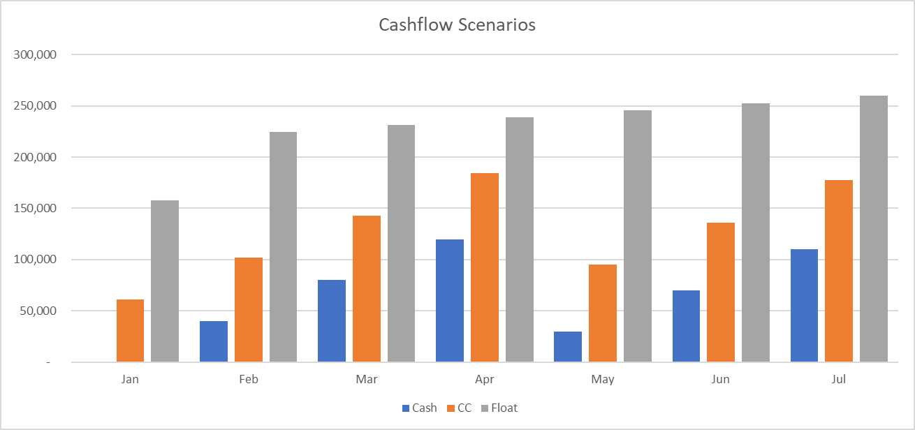

Slide 7

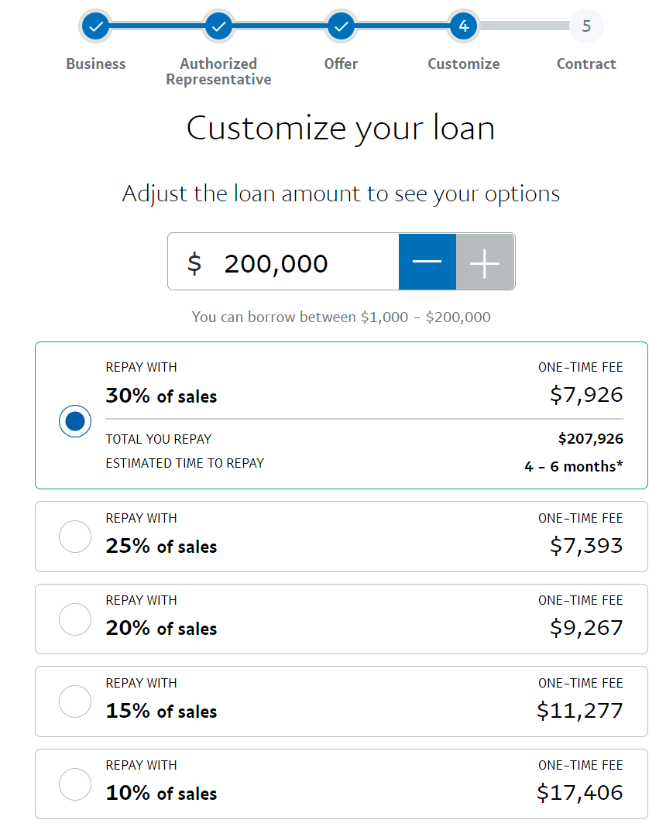
Interest rate vs fees

Slide 8
Cheap money is available to you!

