Slide 1
Consumer Confidence and Macro Trends

Slide 2
Landscape
Unemployment 3.5%
Inflation slowing but still higher than historical averages
Spending behavior shifting
Mixed bag in optimism but it is improving

Slide 3
McKinsey Research
Responses from 3,973 adults in the United States (sampled and weighted to match the general US population) the survey results paired with third-party data on consumer spending for the final analysis. The following seven charts are highlights from this research.

Slide 6
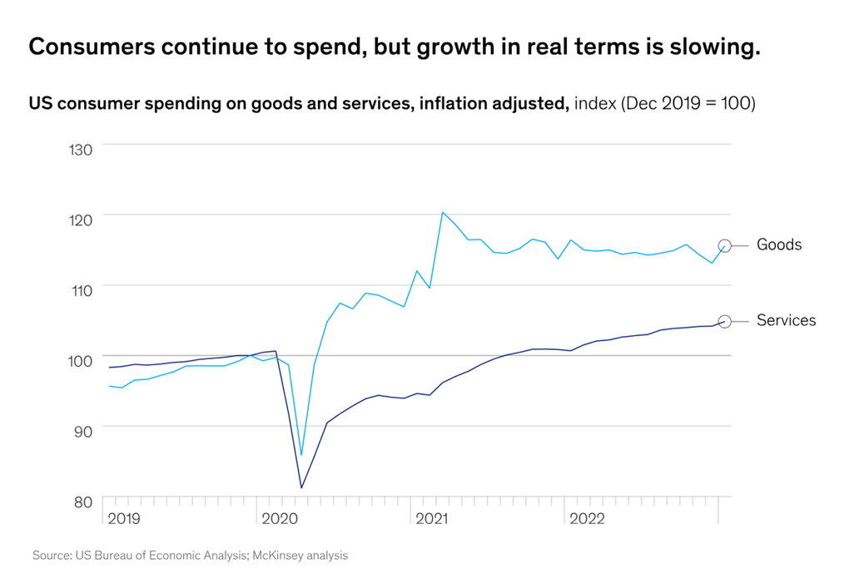

Slide 10
Key take aways:
- Consumers are shifting their spend toward experiences/travel
- Vast majority of people are indicating that they are “trading down”
- Youngest generation is most eager to splurge (but they have the least amount of resources)
- Economic optimism is slowly improving

