Slide 1
COLAB Conference 2023
Raising Capital
September 2023

Slide 2

Raising Capital
Need for Funds
Company Stage
Funding Sources
Strategic Money
Types of Fund Raises
Use of Funds
Pitch Prep
Advisors
* Not financial advise. Consult your accounting / finance / legal professionals

Slide 3

Funding Needs
Marketing and brand building
Launch or campaign
Hiring key team members
R & D / Innovation
Production / Inventory
Growth of company

Slide 4

Company Stage
Continued growth and expansion beyond the resources accessible to the founder
Utilized available means and need additional resources
    Personal or Self Funded
    Friends and Family
    Individual Investors / Angels
    Venture Funds
    Institutional Lenders

Slide 5
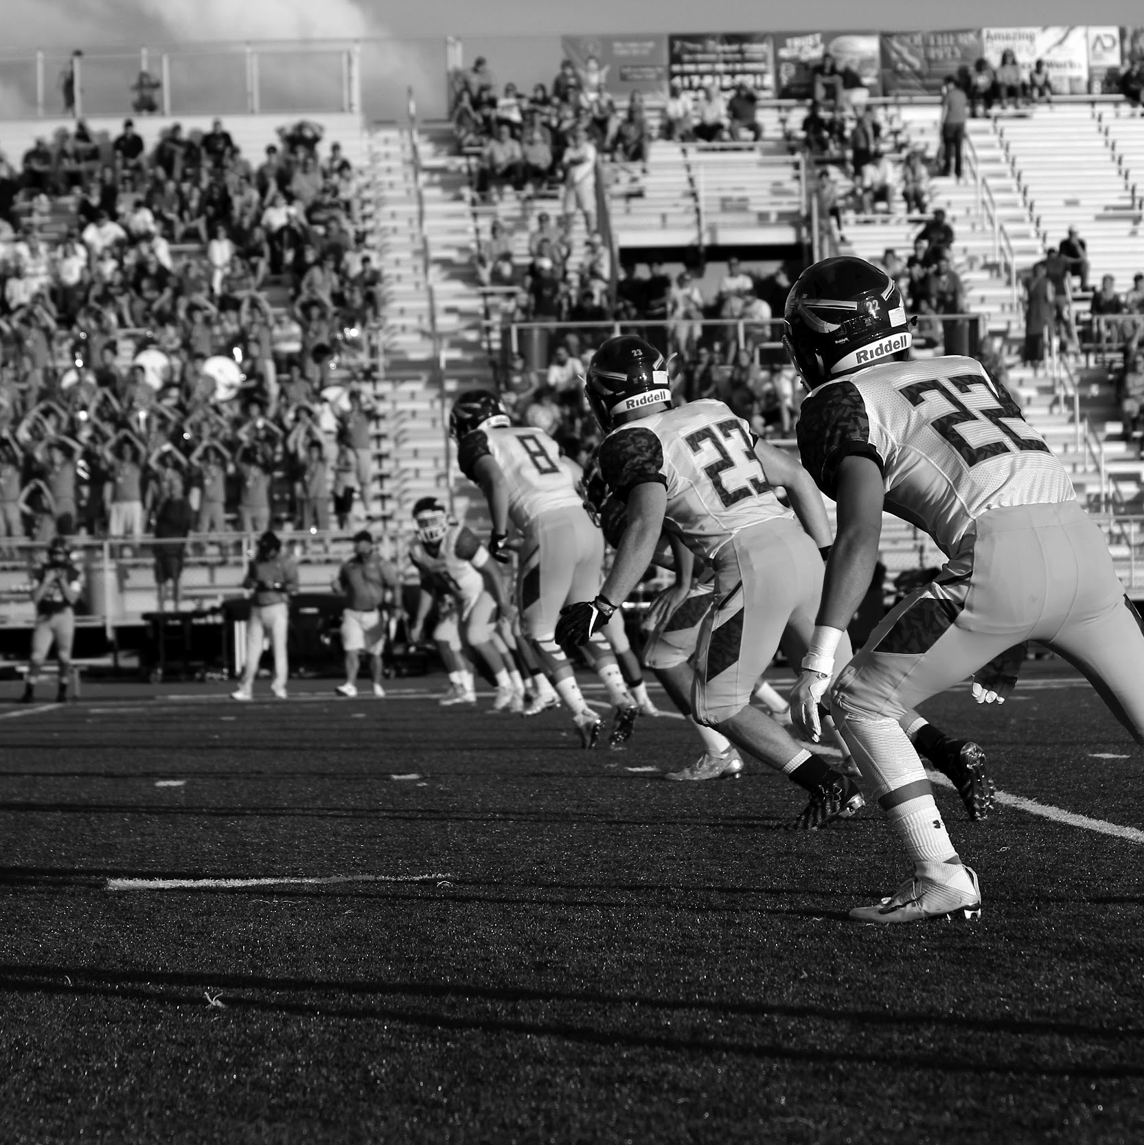
Funding Sources
Individuals and Family Offices
Venture Funds
Impact Funds
Government Economic Development
  Local Government
  State Agencies
  Federal Agencies

Slide 6
Funding Sources and Stages
Concept / Idea
Pre-revenue / MVP
Scale Up
Self Funded
Family
Friends
Individuals / Angels
Individuals / Angels
Institutional Investors
Institutional Lenders
Institutional Investors

Slide 7

Strategic Money
Investors who contribute expertise or market knowledge
Network of the investor
High value level beyond strictly investment dollars
Balance of access to funds along with access to expertise / network

Slide 8

Funding / Investment Vehicles
Idea / Concept Stage
  SAFE
  Convertible Notes
  ”Handshake Agreements”
Pre-Revenue / MVP / Revenue
  SAFE
  Convertible Notes
  Priced Equity
Scaling
  Convertible Notes
  Priced Equity

Slide 9

Investment Vehicles
SAFE
Fastest and cheapest way to deploy capital to a new business
Convertible Notes
Converts to equity at pre-negotiated milestones
Priced Equity
Buying equity and bargained-for protective provisions.
Converts to equity at Priced Round
Appropriate for an entity with a limited operating history (Idea, Pre-Revenue)
Earns interest and may come with bargained-for protective provisions for the investor(s).
Higher transaction costs and diligence is likely appropriate
Typically involves extensive technical and legal due diligence prior to investment.
* Source: White Summers

Slide 10
Investment Stages
Company Milestone
Idea / Concept
Pre-Revenue / MVP
Investment Stage
Friends and Family
Investment Vehicle
SAFE
Convertible Notes
Revenue
Scale
Pre-Seed
Seed
Series A, B, etc.
Priced Equity
General Stages

Slide 11
Use of Funds
Growth
Brand Building
Market Share
Team Building
Products / Production
Inventory for Products

Slide 12
Pitch / Fund Raising Prep
Prepare before funds are needed
      Brand Story / Why
      Founder Story / Who
          Product / IP
          Market
          Fit
          Team
          Metrics / Projections

Slide 13
Advisors
Help to fill in gaps on the team or limited founder experience
Market or Subject Matter Expertise
Related Experience
Complementary Experience
”How things are made….”
Advise vs Work

Slide 14
Contact
Jim Chi
Cascade Management Consulting
Product Management
Sustainability Strategies
Global Sourcing and Supply Chain
Go to Market Strategies
International

Slide 15
INVESTMENT COMMITTEE: PRIORITIES
INVESTMENT OPPORTUNITIES
MEMBER EDUCATION
MEMBER ENGAGEMENT
EVALUATE AND SELECT TOP OPPORTUNITIES IN THE SPORTS INDUSTRY
MEMBER INTRODUCTIONS TO NETWORK OF ANGEL GROUPS, INVESTMENT FIRMS, AND VC’S
CURATED EARLY STAGE COMPANIES SOURCED FROM NETWORK
LEARNING THROUGH SELF PACED INVESTMENT EDUCATIONAL RESOURCES
ANGEL ASSOCIATIONS - ACA
AFFILIATE VC ORGANIZATIONS
PEER MEMBER LEARNING
INDUSTRY EXPERT PRESENTATIONS
PROVIDE PLATFORM TO BIPOC / WOMEN FOUNDERS
MENTORSHIP AND ADVISORY RESOURCES FOR FOUNDERS
OPPORTUNITIES AS MENTORS AND ADVISORS

Slide 16
INVESTMENT COMMITTEE: 2023
Portfolio Companies
$100K Invested AND 4 Members

