Slide 1
Emotional Intelligence
For Lifestyle Apparel Brands
COLAB Conference 2022
Will Henson Psy.d

Slide 2
Today’s Learning Objectives
What is “Emotional Intelligence” and why is it important to business success?
What are the components of emotional intelligence
How do you develop Emotional Intelligence in ways that lead to increased performance for yourself, your employees and your company

Slide 3
Resistance to EI Concepts
Emotional Intelligence is something people should think about at home, not work. And certainly not in a high level business environment.
Emotional Intelligence is for people who “have issues” or are weak.
Emotional Intelligence is too soft / for whiny people
Emotional intelligence is about “weird stuff” like yoga, essential oils, mindfulness (etc…)
IF YOU THINK EI IS WHIMPY - WATCH HOW TOP PERFORMERS IN ATHLETICS AND BUSINESS TRAIN IN EI

Slide 4
The Real Deal on EI
In the top echelons of business EI is more important than IQ, technical skill, or any other factor
EI is twice as important as technical skill
EI separates the top performers in yearly profit by 20%
EI accounts for 90% of the performance differences among senior leadership in companies.
EI leaders create climates that foster good business
EI CAN BE TAUGHT & LEARNED - it is not a fixed quality

Slide 5
Core Components of Emotional Intelligence
Self-Awareness: Knowing one’s own strengths and weaknesses, drives, values, emotional states and tendencies.
Self-Regulation: Being able to control and redirect thinking, impulses, mood, thought, and attention. This isn’t must about emotion - its about regulating your whole self.
Motivation: Relishing achievement for its own sake, being intrinsically motivated instead of extrinsically motivated.
Empathy: Being able to deeply understand other people’s emotional state
Social Skill: Ability to build rapport, form and repair bonds.

Slide 6
It’s a misnomer that you have to do more to be more. The truth is you have to BE MORE to do more.
Michael Gervais (Sports Psychologist - Seattle Seahawks)

Slide 7
Self-Awareness
Is it really that important?
Research has consistently demonstrated that self-awareness is a crucial trait for business leadership. One study of 72 executives in companies with revenues from $50 Million to $5 Billion found that a high self-awareness score was the strongest predictor of successful business leaders (Green Peak Partners & Cornell University, 2009)
For example: These executives understood their weaknesses and were able to hire subordinates that performed well where they did not.

Slide 8
Self Awareness
What exactly is it?
Self-awareness is a control mechanism that allows people to monitor their internal signals and correctly interpret them and know their own patterns, vulnerabilities and defense mechanisms. It allows us to subvert our automatic behaviors and have more choice.
Top Down Control: is our ability to make choices based on the thought and logic.
Bottom Up “Control” Automatic processes (usually defensive) are in control

Slide 9
Autonomic Arousal

Slide 10
Self Awareness - What is it?
Some Descriptors:
Freud described this as an “evenly hovering attention”
“Such attention takes in whatever passes through it’s awareness with impartiality, as an interested yet unreactive witness.” (Daniel Goleman 1995)
It is a “neural mode that maintains self-reflectiveness amidst turbulent emotions.” (Ibid, 1995)
A slight stepping back from experience in a parallel system of consciousness that is “meta” - hovering aside the main flow of thought and emotion that is non-reactive and non-judgemental.

Slide 11
Self-Awareness
Low EI people interpret critical feedback as failure or threat. Self-aware people do not. Self-aware people have self-confidence: they know their strengths and accept their weaknesses. They can take feedback (a critical component of learning EI).
Self Awareness is probably the root of all EI : because if you are not aware of your internal world, you can’t tune into the quality of your own thinking and feeling – you run on reactivity and habit.
Metacognition = being able to think about your thinking (whoa right?)
(a) Assessing accuracy of your thoughts
(b) Understanding and analyzing your emotions
(c) Managing the direction of your attention
(d) Noticing and managing physical reactions

Slide 12
How to Increase Self-Awareness
Don’t be a whimp. Take a look at what is going on in your head.
Don’t be self-critical - It will impede your ability to examine your own faults, decisions, weaknesses and will trigger defensiveness.
Replace self-criticism with curiosity. Be really curious and ask yourself a lot of questions about your own internal process. Asking questions is more important than getting the answers right away.
Ask someone you trust to give you honest feedback.
Train in the ability to self-regulate (next section).

Slide 13
2. Self-Regulation
Self-Regulation is the ability to be able to control internal processes: It is not just the regulation of emotion but four components.
Thoughts
Emotion & Mood
Attention
Physical Sensations

Slide 14
Self-Regulation : Thought
Cognitive Errors & Defensive Mechanisms
These are automatic negative thoughts, assumptions and beliefs that are reflexive and do not go through scrutiny. They are cognitive shortcuts. Often they are defensive in nature (i.e. designed to make you feel better).
You must learn these and stop using them!
To get better: Catch Yourself Using Thinking Errors

Slide 15
Cognitive (i.e. Thinking) Errors
Blaming: Putting fault somewhere else. “It’s not my fault sales are bad. It’s the economy.”
Minimization: Minimizing painful reality. “It’s not so bad we lost that client.”
Denial: Avoiding painful reality. “I didn’t screw up.”
Catastrophizing: Making things worse. “Inventory is too high, we are going out of business for sure!”
Black and White Thinking: All or nothing. “Debt is bad. We can’t have one cent of debt.”
Rationalization: Making sense out of a mistake. “That order was going to be late anyway. Its not my fault I didn’t work fast enough.”
Results Oriented Thinking: Analysing an action based on past results instead of the quality of the decision. “Last time we took a risk on a new product we lost money.”

Slide 16
Decision-Making
Decision-making is often an unconscious process, made through pattern recognition* and emotional tagging, and is distorted through self-interest, emotional attachment, or misleading memories. When managers learn systematic ways to recognize sources of bias – or “red flag” conditions they can design safeguards
(a) Introduce more analysis
(b) greater debate and,
(c) Stronger governance
*Pattern Recognition : Involves 30 different parts of the brain but we make assumptions based on prior experiences but it can mislead us in unfamiliar situations, causing us to think we understand things we don’t.

Slide 17
Resilience
Resilience is defined by psychologists as an adaptive response in the face of a stressor.
Resilience isn’t just personal toughness, or “picking yourself up by the bootstraps.” Resilience requires relationships and support to be developed properly.
Building resilience in your leadership and organization (from top to bottom) requires an organizational culture that fosters relationships, skill and community (this creates repeated positive interactions)
RESILIENT PEOPLE HAVE THESE THREE QUALITIES
They cooly accept the reality of circumstances that are happening to them.
They making meaning out of their situation.
They are experts at improvising.

Slide 18
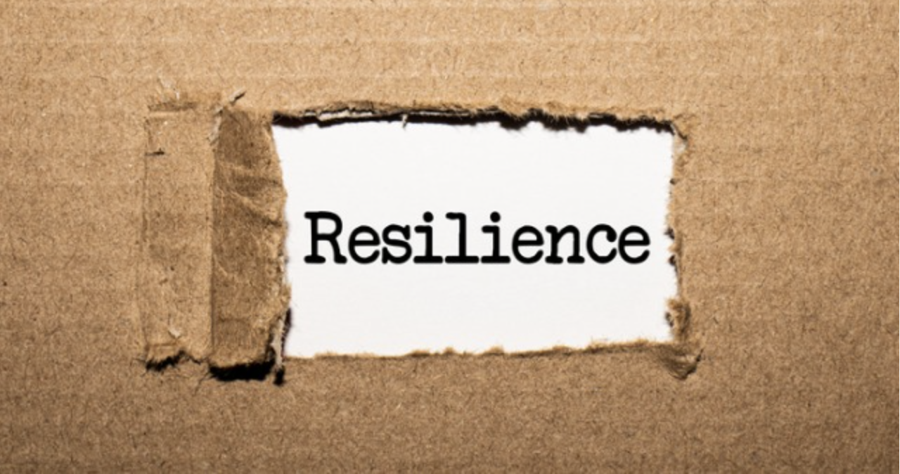
Resilience is a LEARNED behavior
It must be practiced.

Slide 19
Regulating Emotion
Emotions are sign posts, they are reactive and automatic. Feelings are not facts.
Emotions are a result of thoughts (often automatic ones). The thought process regulates emotional response.
Watch for autonomic arousal (Physical response)
Don’t be afraid of emotion, lean into them instead of run from them. Watch them, chase them instead of letting them chase you.
To get better: Practice tolerating the experience.

Slide 20
Mood
A leader’s mood is the most important part of an organization. It sets off a chain reaction in other people. Mood is a result of self-regulation.
Leader mood is more than a “game face.” A leader’s style is extremely influential in the organization and is highly contagious.
Research indicates that when a leader displays a positive mood and attitude subordinates view everything in a more positive light
Upbeat environments foster mental effeicenty, creativity and decision making

Slide 21
Self-Regulation: Attention
Part of self-regulation is where you direct your attention. What do you pay attention do and what do you miss? Don’t spend all your time attending to the negative. (Humans have a hard-wired negative bias in attention.)
PAY ATTENTION TO WHAT YOU WANT MORE OF (opportunity, success, etc…)
There is no such thing as magical thinking but….
THINKING IS MAGIC

Slide 22
3. Motivation
Facts about Motivation:
Intrinsic motivation (success for its own sake) is more powerful and sustainable than extrinsic motivation (getting stuff).
Long-term goals are important but short-term targets must be present and achievable in steps.
Motivation does not give people skills they don’t have.
Focus on results (People with low motivation are fuzzy about results).

Slide 23
Motivation & Optimism
People with high levels of optimism share certain traits including being able to motivate themselves and find ways to accomplish goals and work through tough spots.
People’s belief in their abilities has a profound effect on those abilities.
Optimistic people see failure as something that can be corrected and fixed by their own action while pessimistic people see it as outside of their control.
Seligman (1987) found that salesmen who scored high on measures of optimism sold 37% more in their first two years and quit at half the rate of pessimists.

Slide 24
4. Empathy
Empathy involves understanding and relating to people from their own point of view and involves a concordant emotional response.
In studies by the Management Research Group, empathy was found to be the strongest predictor of ethical leadership behavior out of 22 competencies in its management model, and empathy was one of the three strongest predictors of senior executive effectiveness.
To Get Better: Practice!

Slide 25
5. Social Skill
Social Skill isn’t one thing, it’s huge number of interrelated abilities.
Social skill is more than friendliness. It is not manipulative or technique- based. It’s not about being popular or liked.
Poor interpersonal skills lead to underperformance as an executive. Executives whose interpersonal skill scores were low scored badly on every single dimension of performance.
Traits such as arrogance, over-directness, impatience, stubbornness directly correlate with lower financial results in organizations (and many other dimensions of executive performance).

Slide 26
Social Skill: Agreeableness
Agreeableness is one of the big factors in human social judgement and consists of several dimensions:
Trust
Straight-Forwardness (speaking honestly & transparently)
Altruism (Good intentions, selflessness, generosity, consideration)
Compliance (Preference for cooperation over conflict)
Modesty
Sympathy (Emotion is considered in decision-making)
Summation: Other people will like you if you are good to them.

Slide 27
Social Skill: Charisma
Charisma is your social “magnetism” - How much people like and respect you. According to Oliva Foxbane - (The Myth Of Charisma) this consists of
Presence - Being present centered
Power - Being able to affect the world around you and get things done.
Warmth - Your intentions, actively conveyed
These must be harmoniously intertwined
Charisma can be learned - it is not fixed.
Practice these!!!

Slide 28
Social Skill: Warmth
The construct of Warmth is not about being soft or cuddly
Warmth accounts for __________% of initial social Judgement.
Warmth is very hard to fake.
The number one indicator of warmth is ________________________.

Slide 29
Flow Science
The term Flow (M. Csikszentmihalyi) describes a state of high performance. It is the “ultimate harvesting of emotions” in service of performance. It involves full engagement in the task at hand.
Entering flow requires either:
“A sharp attendance to the task at hand in a highly concentrated state. Once this focus takes hold it it takes on a life of its own where the self is forgotten and the task becomes effortless.”

Slide 30
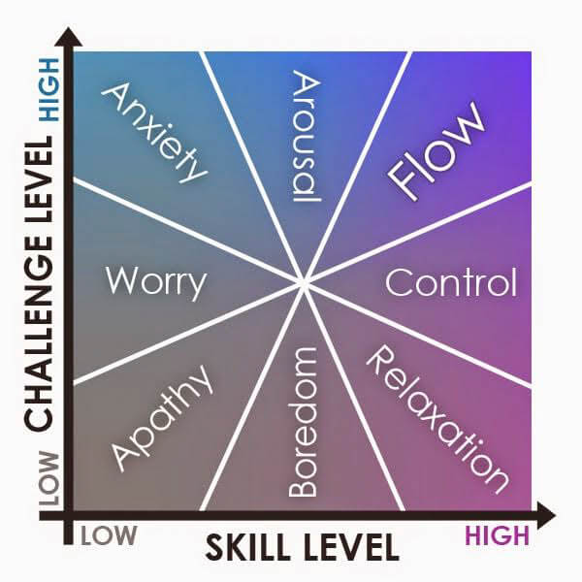
Flow
2. A second way to enter flow is to perform tasks where the demands are high and require higher concentration but within your skill level. The person experiences “spontaneous pleasure, grace and effectiveness.” This type of flow occurs at the edge of ability where skills are well-rehearsed.
This can be a mental or physical task

Slide 31
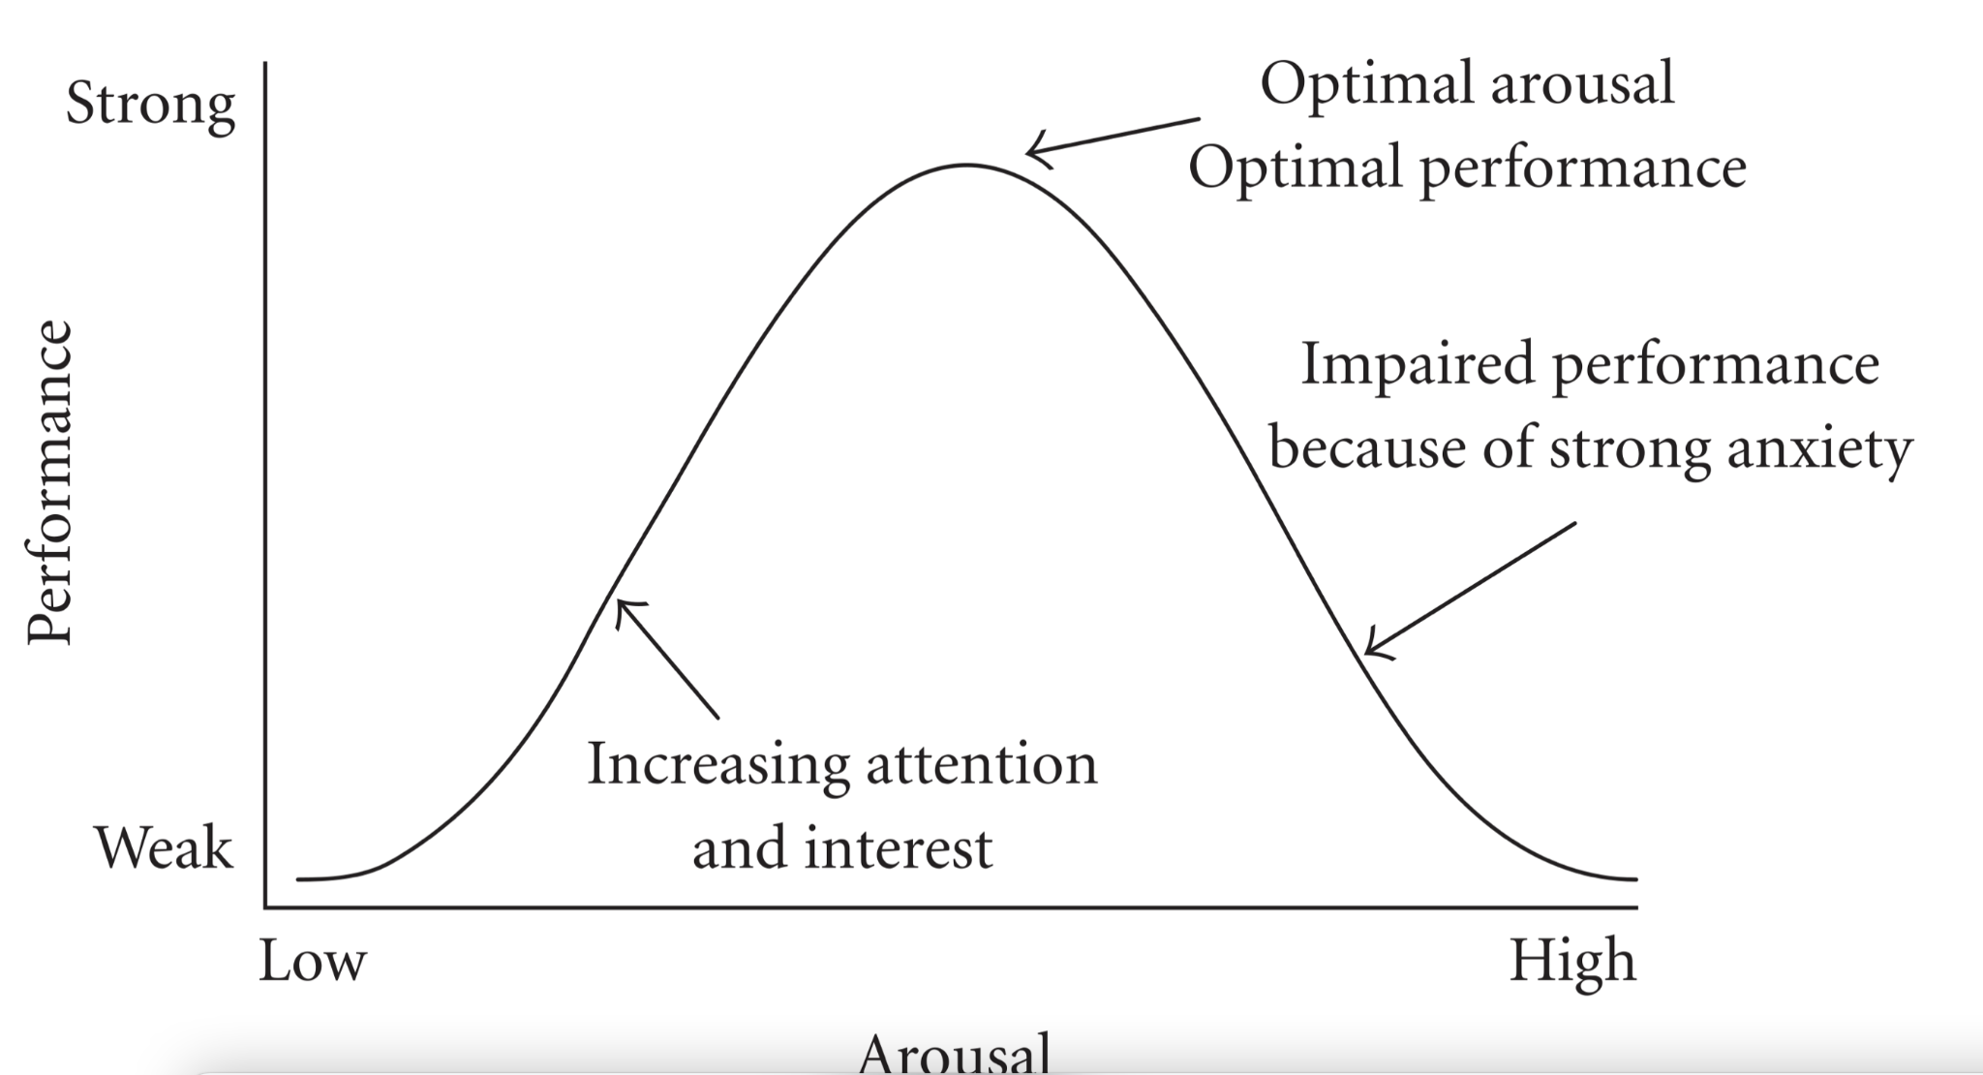
Yerkes-Dodson Law
Describes the empirical relationships between pressure and performance : an ideal state exists for each task. Performance increases with psychological and mental arousal but only up to a point (at which it deteriorates)
Training, over-learning tasks, resilience and self-regulation will decrease anxiety and increase performance.

Slide 32
Training Organizations & Teams

Slide 33
Training in Emotional Intelligence
Neo-Cortical Learning: Your neo-cortex is the thinking part of your brain. It is responsible for (among other things) learning through language and thought. Like you are doing right now. This is how schools function
Limbic System Learning: The limbic system is responsible for emotions, behavior and motivation. It learns differently. The limbic system learns through repetition, feedback and motivation. If you want to improve Emotional Intelligence you can’t just read about it you have to go DO it repeatedly.

Slide 34
Training Everyone
Everyone in your organization benefits from speaking the common language of emotional intelligence in order to improve organizational culture and decision-quality from sales floor staff to receptionists to top leadership.
It requires emotional intelligence to be able to have a resilient and adaptive response to problematic situations. It starts with organizational leaders as leaders have the biggest impact.

Slide 35
Training EI
Don’t rely on a single didactic sit and get. Use trainings as a primer for your staff and use them to create a common language
Integrate aspects of EI into your daily operations, language and supervision with employees. Repetition and practice.
Managers have to know and model what they want employees to use.
80% of employees (and especially younger ones) consider emotional intelligence important to their professional growth.
Be patient, this is a long process: getting frustrated with the team will not work.

Slide 36
Thank You!!
Will Henson Psy.D.
Licensed Clinical Psychologist
willhenson@drhenson.org
503-704-2645

