Slide 1

2023 Tax Considerations
September 19, 2023

Slide 2



Aprio today*
By the numbers
1,700+
Team Members
171
Partners
#1
Fastest Growing Top-100 firm
35+
Services
35+
Languages Spoken
Clients in
50+
Countries
#26
In the U.S.
27%
Team Member
Diversity
900
Retirement Plans
$1.6
Billion in AUM
5 VC
Investments
Morison Global
!
*As of August 2023
Notes:
In 2015 we set out a plan to execute smart strategic mergers, build a talented engaged team, culture, technology and systems and a national firm. Today we look like this…[Ref the slide and its details]

Slide 3





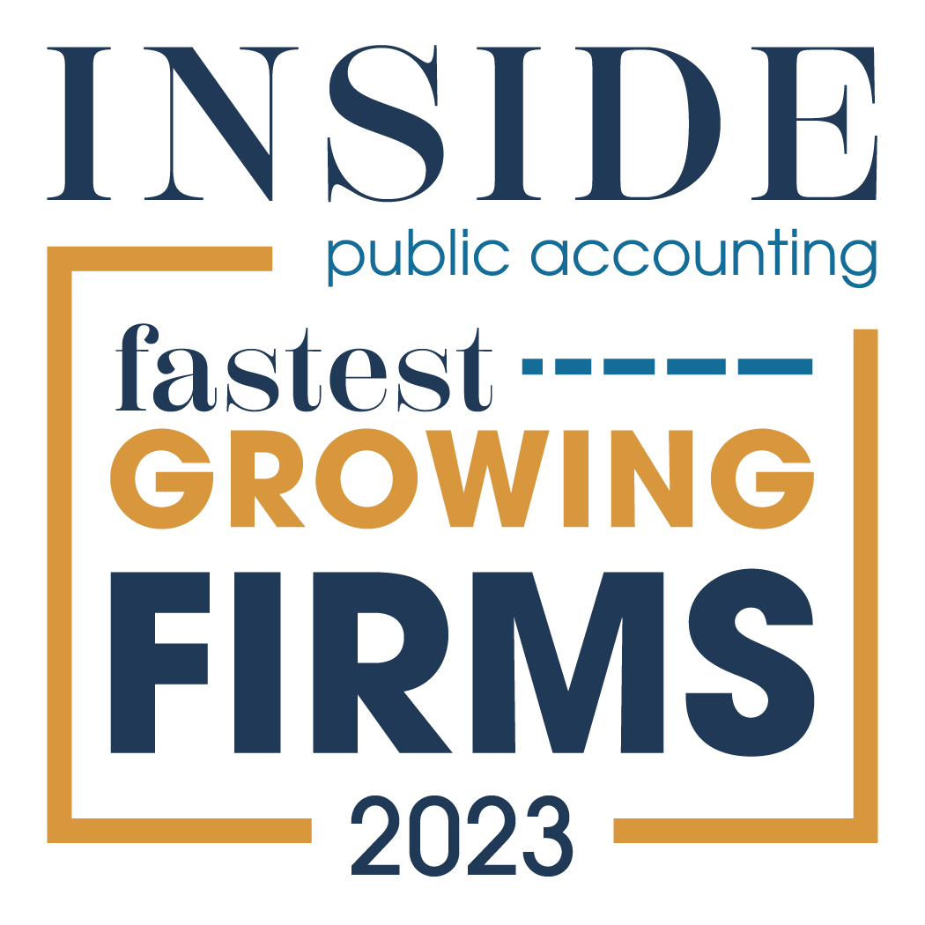























“A Best of the Best Accounting Firm” and Best Place to Work
#1 Fastest growing accounting firm in the nation
#26 largest accounting firm in the nation
A Recognized Leader
The IPA 500
2023
4.7

Slide 4








We are advisors across industries, services and capabilities
Construction | Financial Services | Government Contracting | Individuals / High Net Worth | Manufacturing & Distribution | Nonprofit & Education
Private Equity | Professional Services | Real Estate | Restaurant, Franchise & Hospitality | Technology & Blockchain
PRACTICE GROUPS
INDUSTRIES
Advisory & Consulting
Audit & Assurance
Tax
Wealth
Management
Outsourcing
SPECIALTY TAX
Employee Retention Credit
Paycheck Protection Program
State and Local Tax
Tax Credits and Incentives
International Tax & Transfer Pricing
DIGITAL ADVISORY
Data and Analytics
Blockchain
Digital Transformation
Enterprise Risk Management
Cybersecurity Advisory
Information Assurance
OUTSOURCING
Accounting
Payroll
HR & People Advisory
IT & Financial Staffing
BUSINESS PERFORMANCE
Business Brokerage
Transaction Advisory
Business Valuation
Financial Consulting
Treasury Optimization Services
ERP– Sage, Intact, Unanet & NetSuite
CONFIDENTIAL – Do not copy or distribute

Slide 5
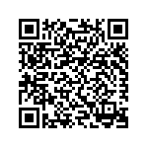
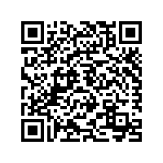
IRC 174
Research and Development Cost Changes
New requirements eliminating the ability to immediately deduct research and development (R&D) expenditures went into effect in 2022 after every attempt to reverse the change failed.
R&D expenses now have to be capitalized and amortized of 5 or 15 years
These rules affect all IRC 174 expenditures, not just those used to generate R&D Credits
Aprio’s R&D Service Page
Aprio’s Latest Article on 174
Notes:
In 2015 we set out a plan to execute smart strategic mergers, build a talented engaged team, culture, technology and systems and a national firm. Today we look like this…[Ref the slide and its details]

Slide 6
2023 Bonus Depreciation Phaseout
80%
Bonus
Depreciation
60%
Bonus
Depreciation
40%
Bonus
Depreciation
20%
Bonus
Depreciation
0%
Bonus
Depreciation
Bonus Depreciation Phase-Out Schedule
Notes:
In 2015 we set out a plan to execute smart strategic mergers, build a talented engaged team, culture, technology and systems and a national firm. Today we look like this…[Ref the slide and its details]

Slide 7
^{Other Items}
Other Items of Consideration
Changes in 163J Interest Expense Limitation rules and computation of ATI
ERC is on the IRS’s Dirty Dozen
FASB 842 Accounting for Leases Tax Considerations
Notes:
In 2015 we set out a plan to execute smart strategic mergers, build a talented engaged team, culture, technology and systems and a national firm. Today we look like this…[Ref the slide and its details]

Slide 8
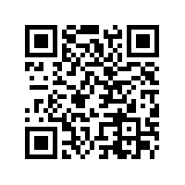
PTET Regimes
Pass Through Entity Tax Regimes
Over 30 States have enacted some time of Pass- Through Entity Tax (PTET)
These regimes allow pass-through entity taxpayers to pay income tax at the entity level to receive a federal deduction for the taxes paid.
PTET Interactive Map
Notes:
In 2015 we set out a plan to execute smart strategic mergers, build a talented engaged team, culture, technology and systems and a national firm. Today we look like this…[Ref the slide and its details]

Slide 9






Pass-Through Entity Tax Considerations
Which states have established a PTE
How to elect into PTE
PTE Tax computation and estimate requirements
How do you apply Pass Through Entity Tax - Credit or income adjustment method
Multi State Considerations
Partner/Shareholder Residency Considerations
Notes:
Reconciliation

Slide 10
^{State and}
^{Local Taxes}
State and Local Tax Nexus
Income Tax Nexus
Physical nexus – employee or property located in state
Factor presence nexus – sales into the state over a state specified threshold
  Thresholds vary by state – generally around $500K
  Do not have to have any physical presence in the state
41 states have personal income tax – 6-10 states have factor presence thresholds (depends on entity type)
Sales Tax Nexus
Economic nexus thresholds - $100,000 of sales or specified number of transactions
46 states have sales taxes and all have economic nexus thresholds
Income tax nexus and sales tax nexus have different analyses but should be evaluated together and on annual basis.
Notes:
In 2015 we set out a plan to execute smart strategic mergers, build a talented engaged team, culture, technology and systems and a national firm. Today we look like this…[Ref the slide and its details]

Slide 11
^{State and}
^{Local Taxes}
Oregon Taxes
Corporate Activity Tax – gross receipts-based tax on all taxpayers
Corporate Net Income Tax – net income tax imposed on all C corporations doing business in the state
Pass Through Entity Tax – elective tax that can be paid by certain S corporations and partnerships doing business in the state
  Election can be made to pay tax at the entity level
Local Taxes
  Portland & Multnomah County Business License Taxes
  Portland Supportive Housing Services Net Income Tax
  Multnomah County Preschool for All Personal Income Tax
  Portland Pay Ratio Surtax
Notes:
In 2015 we set out a plan to execute smart strategic mergers, build a talented engaged team, culture, technology and systems and a national firm. Today we look like this…[Ref the slide and its details]

Slide 12


Thank You
Chris Henderson
Kate Hooker
770-353-2806
Chris.Henderson@aprio.com
240-364 2586
Kate.Hooker@aprio.com

