Slide 1
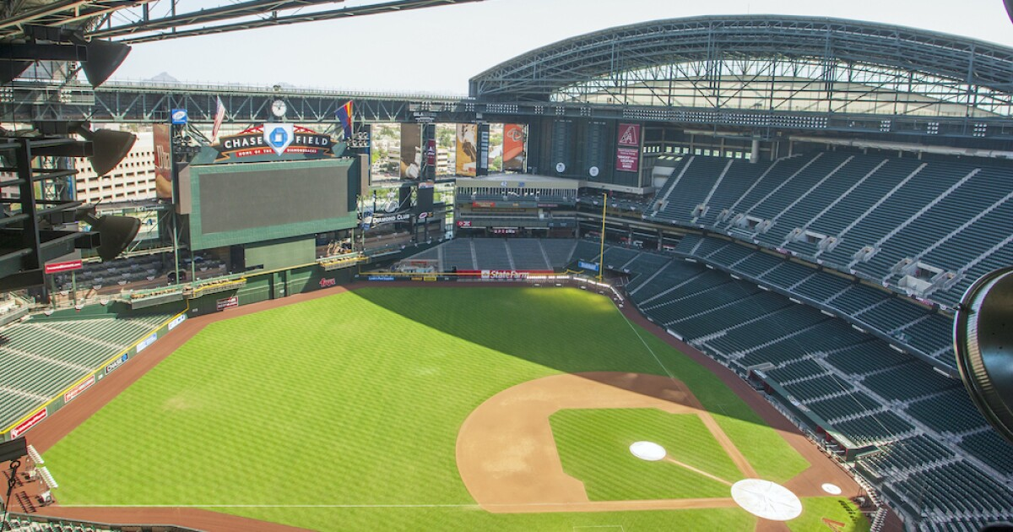

COLAB 2024
Presentation
Collab 2022
Presentation
Presented by:
Tim Cofrin | Tax Partner, Indirect Tax Services
Chris Henderson | Tax Senior Manager, Manufacturing & Distribution

Slide 2

Discussion Agenda
Aprio at a Glance
Pass-Through Entity Tax Elections
State Sales Tax
Federal Tax Updates
Q&A

Slide 3



Aprio today*
By the numbers
2,100+
Team Members
193
Partners
#1
Fastest Growing Top-100 firm
35+
Services
60+
Languages Spoken
Clients in
50+
Countries
#26
In the U.S.
25%
Team Member
Diversity
900
Retirement Plans
$1.6B
AUM
6 VC
Investments
Morison Global
!
*As of Jan 19, 2024

Slide 4








We are advisors across industries, services and capabilities
Construction | Financial Services | Government Contracting | Individuals / High Net Worth | Manufacturing & Distribution | Nonprofit & Education
Private Equity | Professional Services | Real Estate | Restaurant, Franchise & Hospitality | Technology & Blockchain
PRACTICE GROUPS
INDUSTRIES
Advisory & Consulting
Audit & Assurance
Tax
Wealth
Management
Outsourcing
SPECIALTY TAX
Employee Retention Credit
Paycheck Protection Program
State and Local Tax
Tax Credits and Incentives
International Tax
Transfer Pricing
Tax Controversy Services
DIGITAL ADVISORY
Data and Analytics
Blockchain
Digital Transformation
Risk Management Advisory
Cybersecurity Advisory
Information Assurance
Business Applications (ERP)
OUTSOURCING
Accounting
Payroll
HR & People Advisory
IT & Financial Staffing
Indirect Tax
Fractional CFO
Financial Planning & Analysis
BUSINESS PERFORMANCE
Business Brokerage
Transaction Advisory
Business Valuation
Technical Accounting Consulting
Treasury Optimization Services
ESG Services
CONFIDENTIAL – Do not copy or distribute

Slide 5





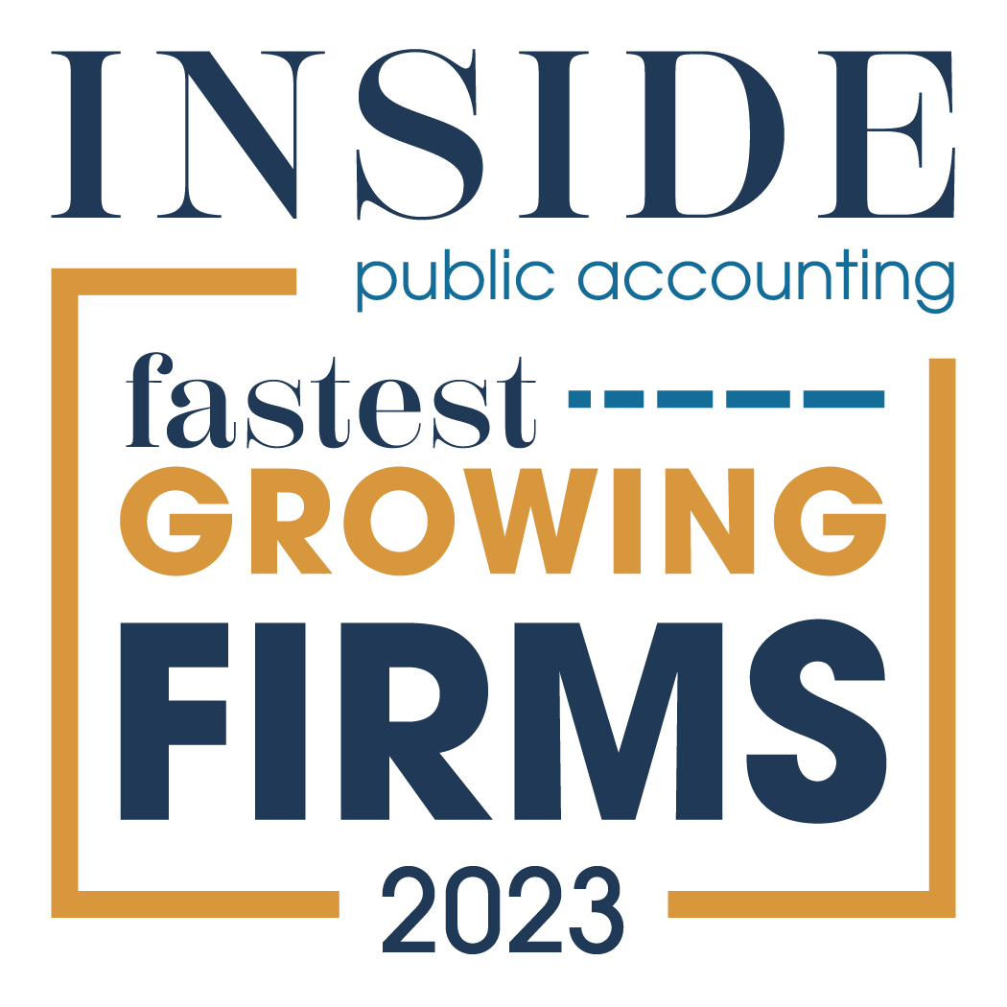



























“A Best of the Best Accounting Firm” and Best Place to Work
#1 Fastest growing accounting firm in the nation
#26 largest accounting firm in the nation
A Recognized Leader
The IPA 500
2023
4.5

Slide 6

Expanding your Business Nationally
Notes:
Insert picture/right click/send to back

Slide 7
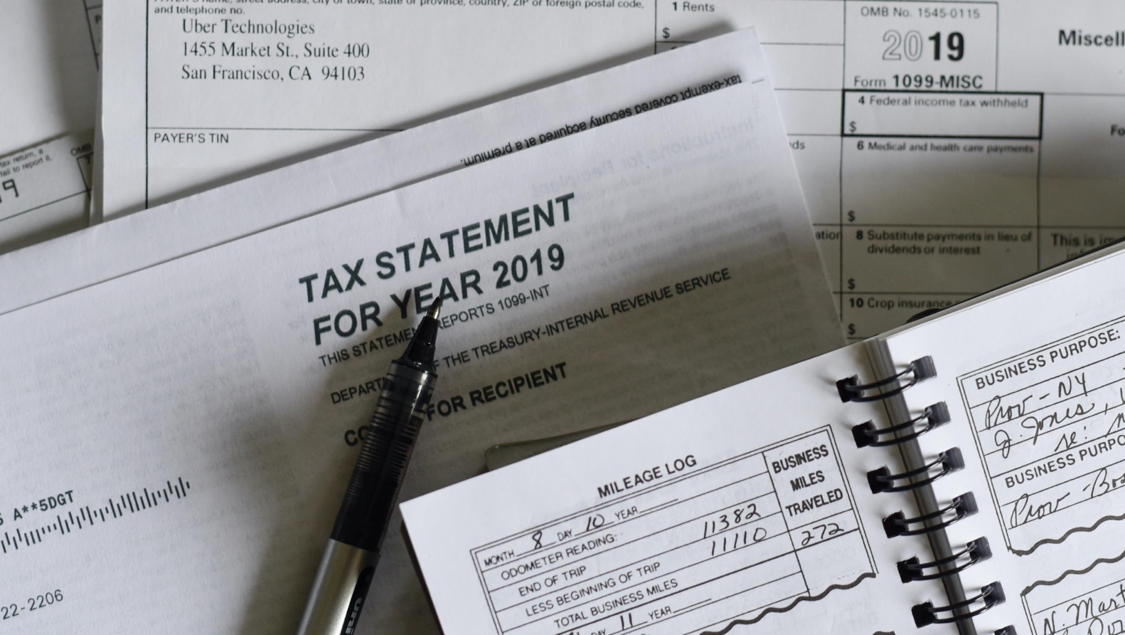
Pass Through
Entity Tax
Notes:
Insert picture/right click/send to back

Slide 8

Pass-Through Entity Tax Elections
Income taxes imposed directly on a pass-through entity (PTE)
  NOT COMPOSITE, which is when the PTE pays the owner’s tax on behalf of the owner – generally viewed more of a procedural obligation
  BUT – owners may be liable for PTE tax if partnership does not pay
  The PTE taxes paid to the states are deductible on the businesses federal return
Used as a workaround to the federal $10,000 SALT deduction cap enacted under TCJA- THIS IS FEDERAL TAX PLANNING
IRS acknowledged these in Notice 2020-75 and more states started enacting
Two main forms
  Owner receives a credit against personal tax for share of PTE tax paid (generally refundable)
  Owner receives an exclusion on their respective state return for the income subjected to PTE tax

Slide 9


Pass-Through Entity Tax Election Comparison
WITHOUT PTE
WITH PTE
State Taxable Income | 1,000,000
Itemized State Tax Deduction | 10,000
Federal Taxable Income | 990,000
Federal Tax | 37%
State Tax | 9%
Federal Tax Amount | 366,300
State Tax Amount | 90,000
Total Tax | 456,300
State Taxable Income | 1,000,000
State PTE Tax | 90,000
Itemized State Tax Deduction | 10,000
Federal Taxable Income | 900,000
Federal Tax | 37%
State Tax | 9%
Federal Tax Amount | 333,000
State Tax Amount | 90,000
Total Tax | 423,000
Total Savings
$33,300

Slide 10






Pass-Through Entity Tax Election Considerations
Which states have established a PTE
How to elect into PTE and qualifying factors
PTE Tax computation and estimate requirements
How do you apply Pass-Through Entity Tax Election Credit or Exclusion
Multi State Considerations
Partner/Shareholder Residency Considerations
Notes:
Reconciliation

Slide 11

Pass Through Entity Tax Regimes
Over 35 States have enacted some time of Pass- Through Entity Tax (PTET)
These regimes allow pass-through entity taxpayers to pay income tax at the entity level to receive a federal deduction for the taxes paid.
Kate Hooker
240-364 2586
Kate.Hooker@aprio.com

Slide 12

State Sales Tax
Notes:
Insert picture/right click/send to back

Slide 13
Aprio offers a comprehensive sales tax solution using a 3-phase approach to addressing your sales tax obligations
Assessment
Mitigation
Maintenance
^{Nexus}
^{Consulting}
^{Voluntary Disclosure, etc.}
^{Ongoing}
^{compliance}
Understand your requirements and compliance tasks and potential exposure
Resolve exposures and limit potential penalties
Stay compliant and manage your ongoing sales tax obligations

Slide 14


Understand where you need to collect sales tax
Sales tax laws have dramatically changed
to catch up to the current economy
Physical Nexus
    People, places, and property
Economic Nexus
    South Dakota v Wayfair US Supreme Court Case

Slide 15

Use and leverage technology to collect sales tax
  Understanding your products taxability
  Do I need a third-party tool to collect sales taxes?
  Can manual rate systems work for my business?
  How do tax collection systems work?
  Should I build or buy a collection tool?

Slide 16
Manage or outsource your compliance
1
State and local filing procedures, how do returns get filed and how frequent are they due?
Should you and how do you leverage technology?
When should you outsource sales tax compliance?
2
3

Slide 17

Federal Tax Updates
Notes:
Insert picture/right click/send to back

Slide 18


Research and Development Cost Changes
New requirements eliminating the ability to immediately deduct research and development (R&D) expenditures went into effect in 2022 after every attempt to reverse the change failed.
R&D expenses now have to be capitalized and amortized of 5 or 15 years
These rules affect all IRC 174 expenditures, not just those used to generate R&D Credits
Aprio’s R&D Service Page
Aprio’s Latest Article on 174
Notes:
In 2015 we set out a plan to execute smart strategic mergers, build a talented engaged team, culture, technology and systems and a national firm. Today we look like this…[Ref the slide and its details]

Slide 19
2023 Bonus Depreciation Phaseout
80%
Bonus
Depreciation
60%
Bonus
Depreciation
40%
Bonus
Depreciation
20%
Bonus
Depreciation
0%
Bonus
Depreciation
Bonus Depreciation Phase-Out Schedule
Notes:
In 2015 we set out a plan to execute smart strategic mergers, build a talented engaged team, culture, technology and systems and a national firm. Today we look like this…[Ref the slide and its details]

Slide 20
Other Items of Consideration
Changes in 163J Interest Expense Limitation rules and computation of ATI
ERC is on the IRS’s Dirty Dozen
FASB 842 Accounting for Leases Tax Considerations

Slide 21

Proposed Legislation
Reversal of 174 capitalization for domestic R&D
100% Bonus Depreciation continuation
163J Interest Limitation- include depreciation & amortization to adjusted taxable income. Allowing more interest to be deducted.
End ERC claims effective 1/31/24
Increase Child Tax Credit for inflation.
Read Aprio’s article on the
Proposed legislation:

Slide 22

Questions

Slide 23




Chris Henderson
Tax Senior Manager
Manufacturing & Distribution
Tim Cofrin
Tax Partner
Indirect Tax Services
Schedule a
Consultation

